Slide 1

Sir Syed University of Engineering & Technology, Karachi
CS-468 Software Quality Assurance & Testing
Week 4
Session 1 & Session 2

Slide 2
Software Process
The concept of a process plays an important role in today’s software development.
Without a repeatable process, the only repeatable results you are likely to produce are errors.
In the software engineering context, a process comprises a set of activities that are executed to develop software products.
The activities ﬁnd expressions in the form of methods, techniques, strategies, procedures, and practices.
Those activities heavily rely on information repositories such as documents, standards, and policies.
Different processes are driven by different goals and availability of resources.
The concept of a process is applied not just to develop source code, but to other software-related products, such as a project plan, requirements document, design document, and user manual, as well.

Slide 3
… Software Process
It is effective to follow a deﬁned process because of the following beneﬁts:
The process can be repeated in subsequent projects.
The process can be evaluated by using a variety of metrics, such as cost, quality, and time to deliver a product.
Actions can be taken to improve the process to achieve better results.
A process for software development consists of several different processes for its different component tasks.
For example, gathering the requirements of a system, constructing a functional speciﬁcation of a system, designing a system, testing a system , and maintaining a system are different tasks to be performed in the life cycle of a software system.
Those different tasks, which are quite different from each other, need different processes to be followed.
A requirements gathering process is fundamentally different from a testing process.
Similarly, a design process is very different from a testing process.
However, some similarities between a maintenance process and a testing process cannot be ruled out because a maintenance task may involve signiﬁcant changes to the design of the system as well as rigorous testing.

Slide 4
Process Improvement
To be able to improve a deﬁned process, organizations need to evaluate its capabilities and limitations.
For example, the capability maturity model (CMM), developed by the Software Engineering Institute (SEI) at Carnegie Mellon University, allows an organization to evaluate its software development processes.
The model supports incremental process improvement.
For an organization, it is more practical to develop a continuously improving process than ﬁnd one which is “just right.”

Slide 5
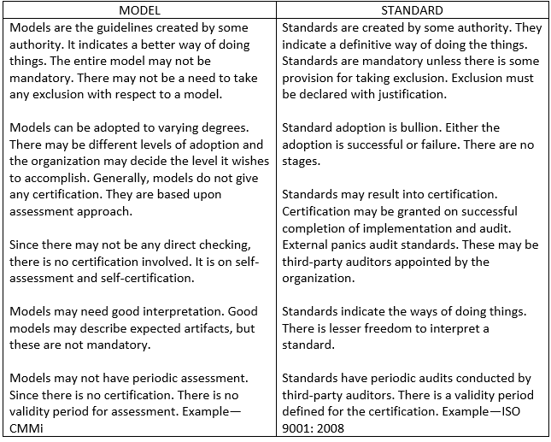
Difference between Models and Standards
It is common experience that standard and model/ are words used interchangeably. Though both indicate similar things and both believe in organizational improvement, there is a small difference between two.

Slide 6
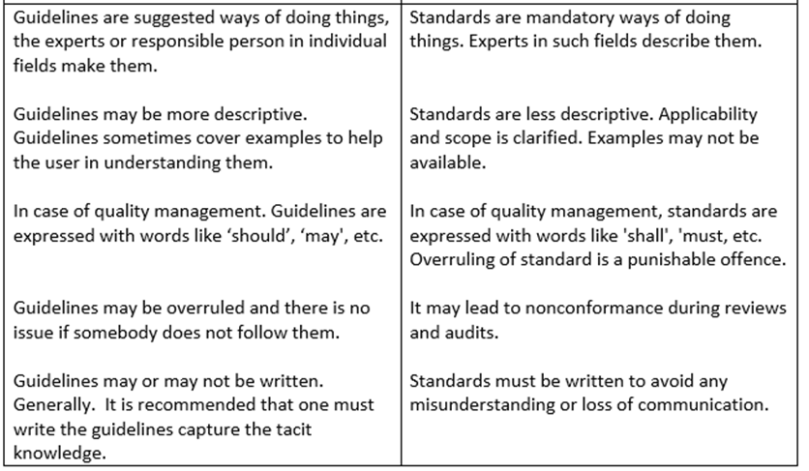
Difference between Standards and Guidelines
Standards may be defined as something mandatory. If the standard is not followed. It can result into some actions. On the other hand, guidelines are suggested ways of doing the things. Guidelines are not mandatory as these are suggestions or better ways of doing the things.

Slide 7
CMM - Capability Maturity Level
The CMM is a framework for evaluating and improving the present capability of a software development company.
As the name suggests, the CMM can be used to assess to what extent the capability of an organization to develop software systems has matured.
The maturity level of a development process tells us to what extent the organization is capable of producing low-cost, high-quality software.
Therefore, the evaluation framework is the CMM.
After evaluating the current maturity level of a development process, organizations can work on improving the process to achieve the next higher level of process maturity.
The model allows one to evaluate an organization by examining its current practices.
Basically, the CMM is a process improvement approach.

Slide 8
CMM - Capability Maturity Level
An immature organization may not have a deﬁned process, and, even if there is one, the organization may not follow it.
Developers and managers react to problems when they occur, rather than take preventive measures to eliminate them or reduce the frequency of their occurrences.
In other words, product and process problems are resolved in an ad hoc manner.
Estimates of cost, schedule, and quality are highly inaccurate due to the absence of a measurement program to gather process data.
Hence, projects overrun cost and time estimates by a large factor. There is no measurement program to evaluate product or process quality.

Slide 9
CMM - Capability Maturity Level
A mature organization carries out its activities in a planned manner.
Both process and product characteristics are measured to keep track of progress and quality of products.
Estimates are more accurate due to following a rigorous measurement program. Employees are kept abreast of new developments through training.
Continual effort is made to improve the quality of products while bringing down costs and lead times.
Deﬁned processes are continually updated to take advantage of new techniques, tools, and experience from past projects.
As an organization becomes more and more mature, standards and organizational policies play key roles in product development.
Organizations become mature in an incremental manner; that is, processes are improved in an evolutionary approach, rather than effecting drastic changes.

Slide 10
CMM - Capability Maturity Level
The model allows one to give a rating to an organization on a scale of 1–5, where 5 represents the highest maturity level.
In order to move to the next level of maturity, organizations need to adopt new practices relevant to the next maturity level.
Level 1 is the initial level,
level 2 is known as repeatable,
level 3 is the deﬁned level,
level 4 is managed,
and level 5 is the optimizing level.
Each level is characterized by a set of key process areas.
It is useful to recall that the CMM focuses on the entire development process.
As an organization moves from one level to the next, its process capability improves to produce better quality software at a lower cost.
The CMM deﬁnes ﬁve distinct levels of maturity, where level 1 is the initial level and level 5 is the highest level of process maturity.

Slide 11
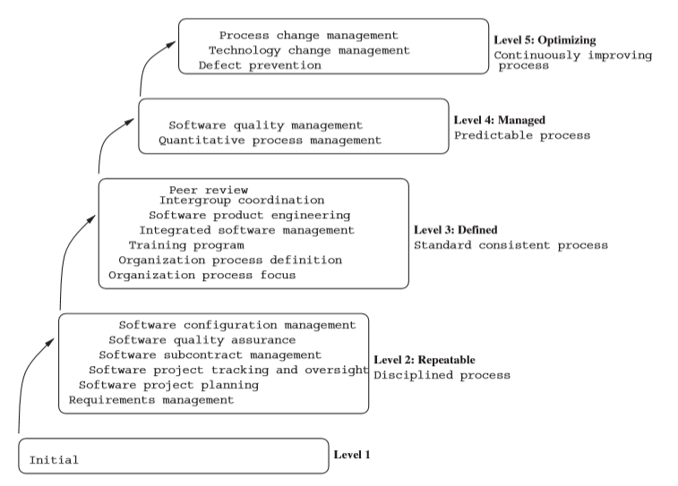
CMM - Capability Maturity Level

Slide 12
CMM - Capability Maturity Level
Level 1 is the initial level:
Software is developed by following no process model.
There is not much planning involved.
Even if a plan is prepared, it may not be followed.
Individuals make decisions based on their own capabilities and skills.
There is no KPA associated with level 1.
An organization reaches level 1 without making any effort.

Slide 13
CMM - Capability Maturity Level
Level 2 is known as repeatable … :
At this level, the concept of a process exists so that success can be repeated for similar projects.
Performance of the proven activities of past projects is used to prepare plans for future projects.
This level can be summarized as being disciplined because processes are used for repeatability.
All the processes are under the effective control of a project management system.

Slide 14
CMM - Capability Maturity Level
…. Level 2 is known as repeatable:
The KPAs at level 2 are as follows:
Requirements Management:
It is important to establish a common understanding between the customer and developers.
Details of a project, such as planning and management, are guided by a common view of customer requirements.
Software Project Planning:
This means creating and following a reasonable plan for realizing and managing a project.
Software Project Tracking and Oversight:
This means making the progress of a project visible so that management is aware of the status of the project.
Corrective actions can be taken if the actual progress of a project signiﬁcantly deviates from the planned progress.
Software Subcontract Management:
This means evaluating, selecting, and managing suppliers or subcontractors.
Software Quality Assurance:
This means evaluating processes and products to understand their effectiveness and quality.
Software Conﬁguration Management:
This means ensuring the integrity of the products of a project as long as the project continues to exist.

Slide 15
CMM - Capability Maturity Level
Level 3 is the deﬁned level …. :
Documentation plays a key role. Processes that are related to project management and software development activities are documented, reviewed, standardized, and integrated with organizational processes.
In other words, there is organization wide acceptance of standard processes.
Software development is carried out by following an approved process.
Functionalities and the associated qualities are tracked.
Cost and schedule are monitored to keep them under control.

Slide 16
CMM - Capability Maturity Level
… Level 3 is the deﬁned level:
The KPAs at level 3 are as follows:
Organization Process Focus: This means putting in place an organization wide role and responsibility to ensure that activities concerning process improvement are in fact followed.
Organization Process Deﬁnition: Certain practices are useful irrespective of projects. Thus, it is important to identify and document those practices.
Training Program: Individuals need to be trained on an on-going basis to make them knowledgeable in application domains and new developments in software techniques and tools. Training is expected to make them effective and efﬁcient.
Integrated Software Management: This means integrating an organization’s software engineering and management activities into a common, deﬁned process. Integration is based on commercial and technological needs of individual projects.
Software Product Engineering: This means following a deﬁned process in a consistent manner by integrating the technical activities to produce software with desired attributes. The activities include requirements elicitation, functional design, detailed design, coding, and testing.
Intergroup Coordination: This means that a software development group coordinates with other groups, such as customers, the marketing group, the and software quality assurance (SQA) group, to understand their needs and expectations.
Peer Review: Work products, such as requirements, design, and code, are reviewed by peers to ﬁnd defects at an early stage. Peer reviews can be performed by means of inspection and walkthrough.

Slide 17
CMM - Capability Maturity Level
Level 4 is managed:
At this level, metrics play a key role.
Metrics concerning processes and products are collected and analysed.
Those metrics are used to gain quantitative insight into both process and product qualities.
When the metrics show that limits are being exceeded, corrective actions are triggered.
For example, if too many test cases fail during system testing, it is useful to start a process of root cause analysis to understand why so many tests are failing.
The KPAs at level 4 are as follows:
Quantitative Process Management:
Process data indicate how well a process is performing. If a process does not perform as expected, the process is improved by considering the measured data.
Software Quality Management:
The quality attributes of products are measured in quantitative form to have a better insight into the processes and products. Improvements are incorporated into the processes, and their effectiveness is evaluated by measuring product quality attributes.

Slide 18
CMM - Capability Maturity Level
Level 5 is the optimizing level … :
At this level, organizations strive to improve their processes on a continual basis.
This is achieved in two steps:
Observe the effects of processes, by measuring a few key metrics, on the quality, cost, and lead time of software products
effect changes to the processes by introducing new techniques, methods, tools, and strategies.

Slide 19
CMM - Capability Maturity Level
… Level 5 is the optimizing level:
The following are the KPAs at level 5:
Defect Prevention:
This means analysing the root causes of different classes of defects and taking preventive measures to ensure that similar defects do not recur.
Technology Change Management:
This means identifying useful techniques, tools, and methodologies and gradually introducing those into software processes.
The key idea is to take advantage of new developments in technologies.
Process Change Management:
This means improving an organization’s processes to have a positive impact on quality, productivity, and development time.

Slide 20
ISO - SOFTWARE QUALITY STANDARD
A global initiative for understanding the concept of software quality has been performed by experts around the world.
Their collaborative effort has led to the standardization of the quality concept by the ISO in the form of documents ISO 9126 and ISO 9000:2000.
The document ISO 9126 is about quality characteristics, whereas the ISO 9000:2000 document is a quality assurance standard.
What is called quality factor in the McCall model is called quality characteristic in the ISO 9126 model.
However, there are several differences between the two models.
The ISO 9126 model focuses on characteristics visible to the users, whereas the McCall model emphasizes internal quality as well.

Slide 21
ISO - SOFTWARE QUALITY STANDARD
There are three components of the ISO 9000:2000 standard, namely,
ISO 9000, ISO 9001, and ISO 9004.
The ISO 9000 document is about fundamentals and vocabulary,
the ISO 9001 document is about requirements,
and the ISO 9004 document contains guidelines for performance improvements.
The ISO 9000 document is based on eight principles: customer focus, leadership, involvement of people, process approach, system approach to management, continual improvement, factual approach to decision making, and mutually beneﬁcial supplier relationships.
The ISO 9001 document deals with the following ﬁve kinds of requirements: systemic requirements, management requirements, resource requirements, realization requirements, and remedial requirements.

Slide 22
ISO 9000 – 8 Principles
The ISO 9000 document is based on eight principles:
Customer focus: to satisfy customers
Leadership: Leaders set the direction their organization should take, and they must effectively communicate this to all the people involved in the process.
Involvement of people:
Organizations rely on people.
People are informed of the organizational direction, and they are involved at all levels of decision making.
People are given an opportunity to develop their strength and use their abilities.
People are encouraged to be creative in performing their tasks.
Process approach.
System approach to management: A system is an interacting set of processes.
Continual improvement.
Factual approach to decision making:
Decisions may be made based on facts, experience, and intuition.
Facts can be gathered by using a sound measurement process.
and mutually beneﬁcial supplier relationships: terms and contract with third parties.

Slide 23
ISO 9001 – 5 kind of Requirements
The ISO 9001 document deals with the following ﬁve kinds of requirements:
Systemic requirements: The concept of a quality management system (QMS) is the core of part 4 of the ISO 2001:2000 document. A quality management system is deﬁned in terms of quality policy and quality objectives and properly document it.
Management requirements: Upper management must accept the fact that quality is an all-pervasive concept. Upper management must make an effort to see that the entire organization is aware of the quality policies and quality goals. This is achieved by deﬁning and publishing a QMS and putting in place a mechanism for its continual improvement. The QMS of the organization must be supported by upper management with the right kind and quantity of resources.
Resource requirements: Resources are key to achieving organizational policies and objectives. Statements of policies and objectives must be backed up with allocation of the right kind and quantity of resources.
Realization requirements: This part deals with processes that transform customer requirements into products.
Remedial requirements: This part is concerned with measurement, analysis of measured data, and continual improvement. Measurement of performance indicators of processes allows one to determine how well a process is performing.

